Slide 1



Exceptions
-Group 1 -

Slide 2


Exception definition
Types of Exceptions
Exception handling
Errors
Contents

Slide 3

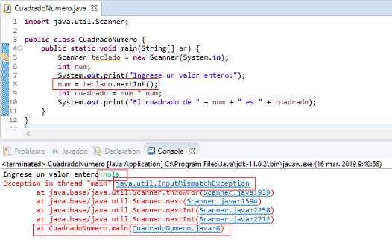

Exception definition
An exception is an abnormal condition that arises in a code sequence at run time. In other words, an exception is a runtime error.

Slide 4
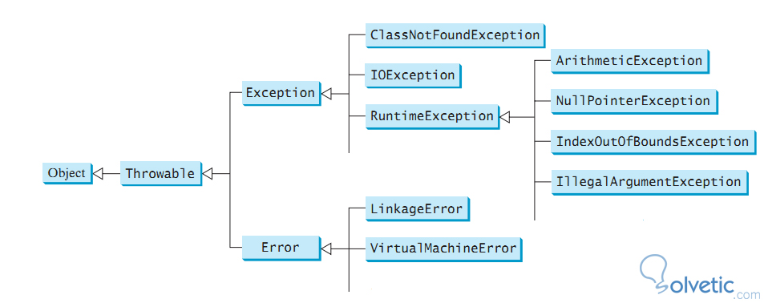
Types of Exceptions

Slide 5
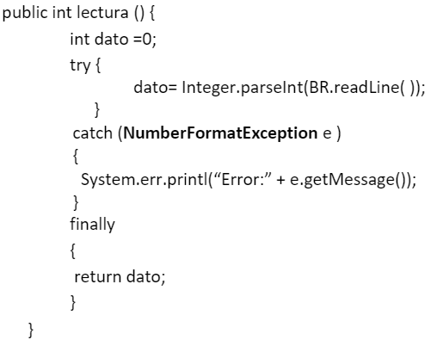

Exception handling
When an exceptional condition arises, an object representing that condition is created and sent to the method that caused the error. That method can decide between handling the exception itself or throwing it. In either case, at some point the exception is caught and processed. If the exception is not caught, the program will automatically terminate.
Exception handling in Java is accomplished using five keywords:
• try
• catch
• throw
• throws
• finally

Slide 6
Errors
A Java bug is a serious problem that occurs during the execution of a program and is usually caused by external conditions beyond the programmer's control, such as a lack of memory, operating system crash, or hardware problem.

